Slide 1
Convolutional neural network

Slide 2
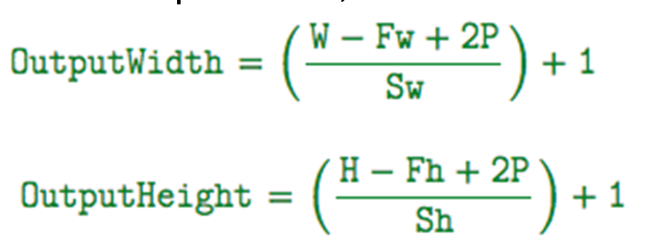
32 * 32 * 3
input
Convolution
30 * 30 *32
Male
Female
Max Pooling
15 * 15 * 32
Fully Connected Layer
Convolution
13 * 13 * 32
1152
6 * 6 * 32
Flatten
Max Pooling

Slide 3
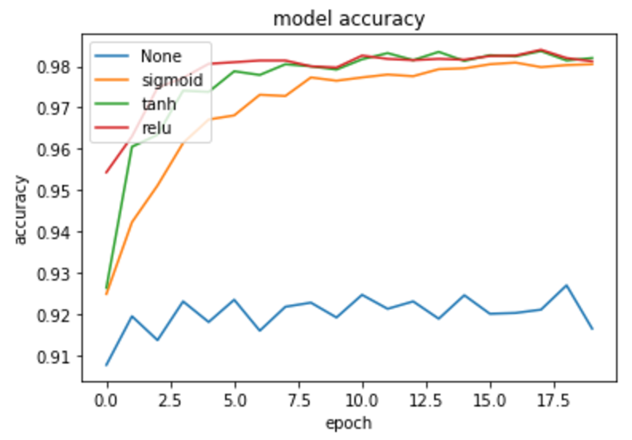
Convolutional Layers
Image(32 ,32,3 )
Take : 32 Filter (3 ,3 )
Use activator function “relu”

Slide 4
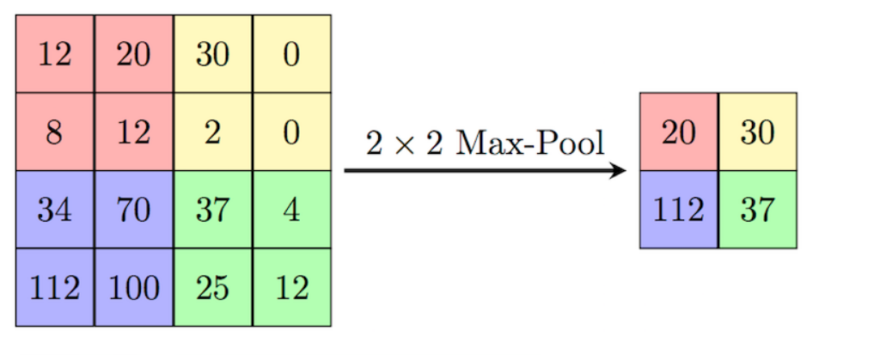
MaxPooling

Slide 5
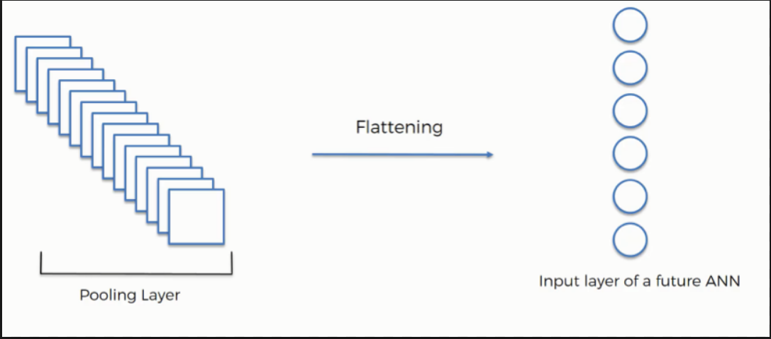
Flatten
Convert pooled feature map to vector such as :

Slide 6
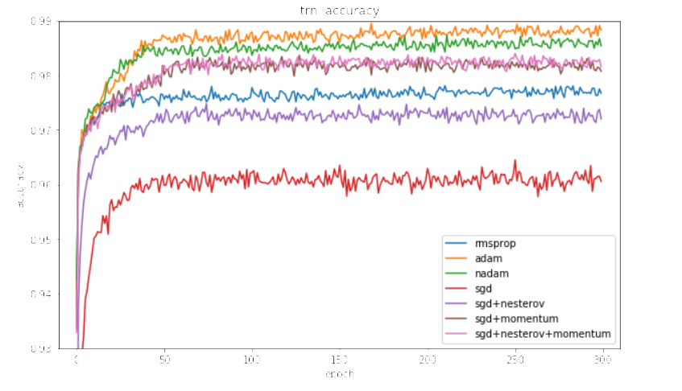
Optimizer “Adam”
algorithm for first-order gradient-based optimization of stochastic objective functions

Slide 7
Batch Size Vs Steps Vs Epoch
1) Steps - number of times the training loop in your learning algorithm will run to update the parameters in the model. In each loop iteration, it will process a chunk of data, which is basically a batch. Usually, this loop is based on the Gradient Descent algorithm.
2) Batch size - the size of the chunk of data you feed in each loop of the learning algorithm. You can feed the whole data set, in which case the batch size is equal to the data set size.You can also feed one example at a time. Or you can feed some number N of examples.
3) Epoch - the number of times you run over the data set extracting batches to feed the learning algorithm.

Slide 8
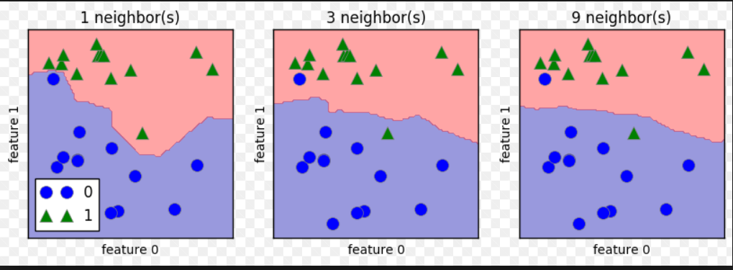
KNeighborsClassifier

Slide 9
KNeighborsClassifier
Run result :
when k= 5 ==> the score = 76.37% on 25000 image on pixels when k = 5 ==> the score = 73.04% on 25000 image on feture
when k = 9 ==> the score = 77.58% on 25000 image on pixels
When k= 9 ==> the score = 77.10% on 50000 image on pixels
when k = 1 ==> the score = 75% on 60000 image on pixels
when k = 2 ==> the score = 74% on 60000 image on pixels
when k = 3 ==> the score = 78% on 60000 image on pixels

Slide 10
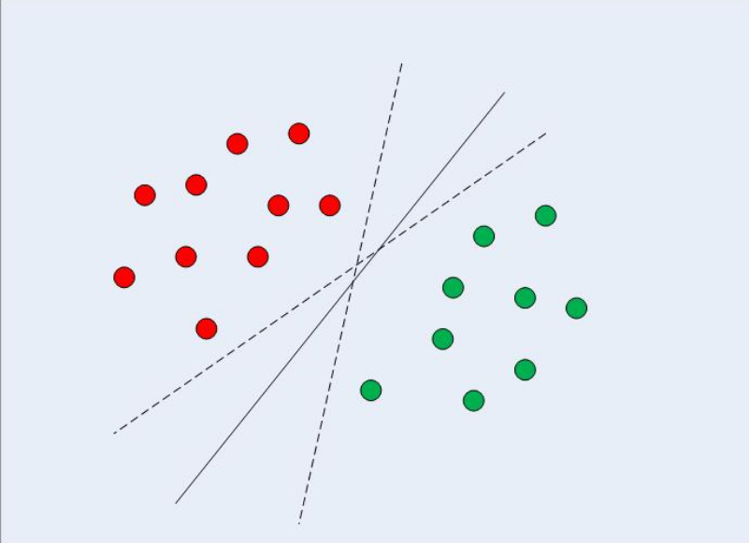
Support Vector Machines

